Slide 1
AWS Integration
This document showcases Deployit integration with AWS’s S3 and ELB components
This is being tested out on a linux environment
The scripts written to interact with AWS
Run from local machine running deployit server
Are written in python
Use BOTO python library to interact with AWS
Doesn’t use Deployit cloud pack
ELB integration showcases
Creating X number of VMs from an AMI template
Adding those new VMs to existing ELB
S3 integration showcases
Copying of single file to S3 as deployment
Copying of folder with files to S3 as deployment

Slide 2
ELB Integration

Slide 3
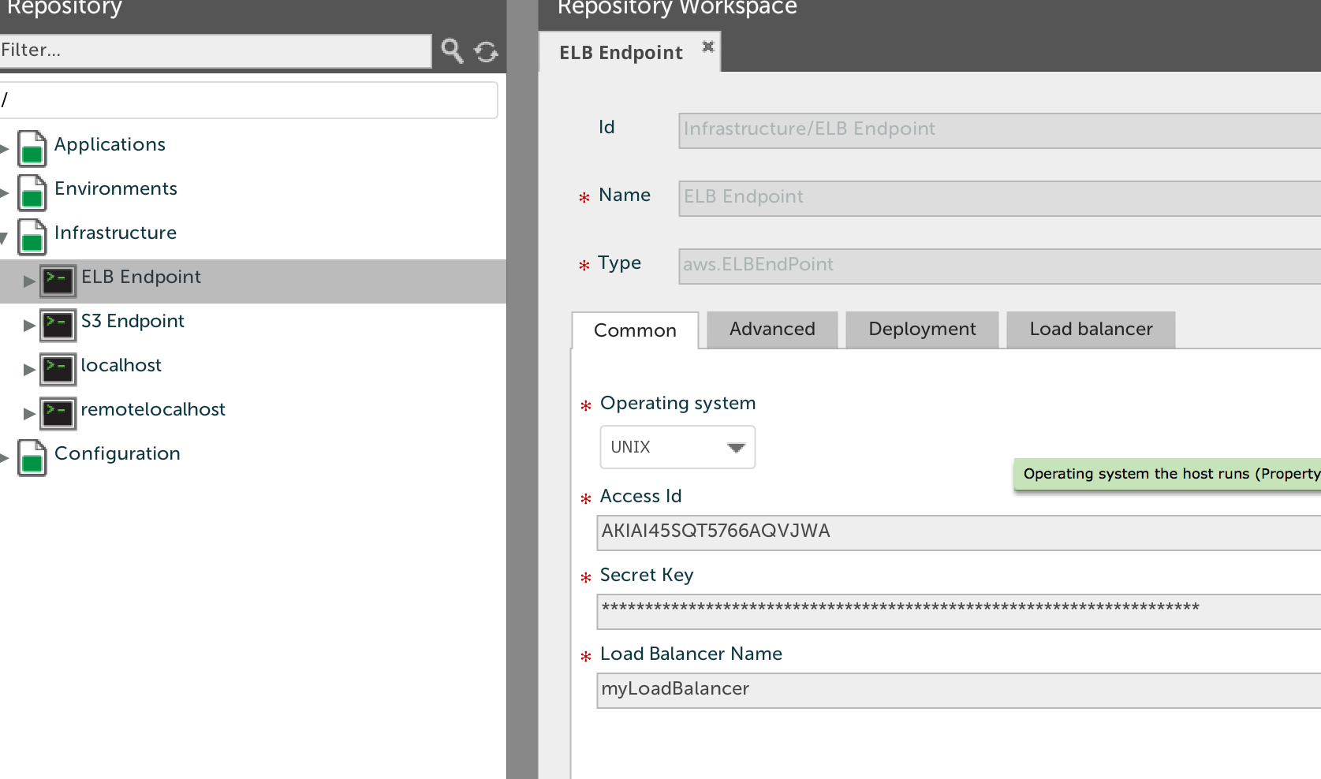
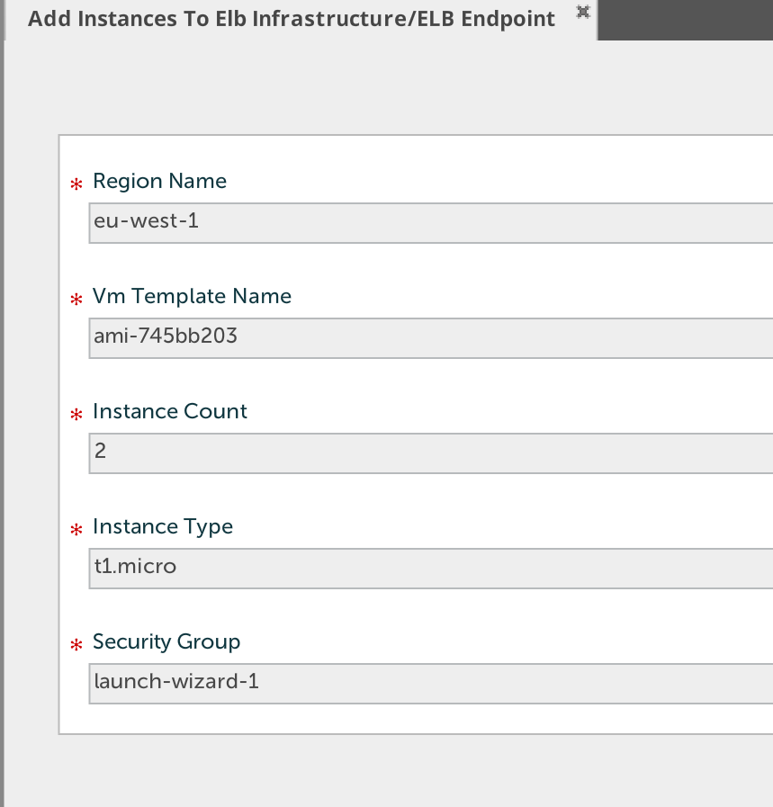
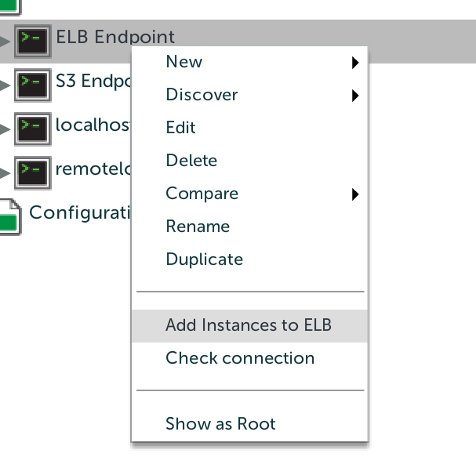
ELB Endpoint Type Added
Requires
AccessId
Secret Key
LoadBalancer Name
Right Click and Select
Add Instances to ELB
Provide Configuration
Region
Template
Count
Machine type
Firewall group

Slide 4
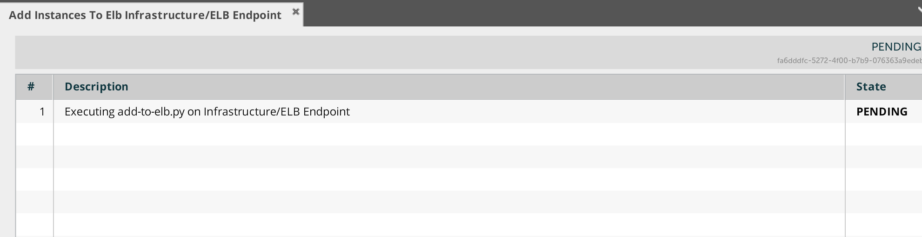
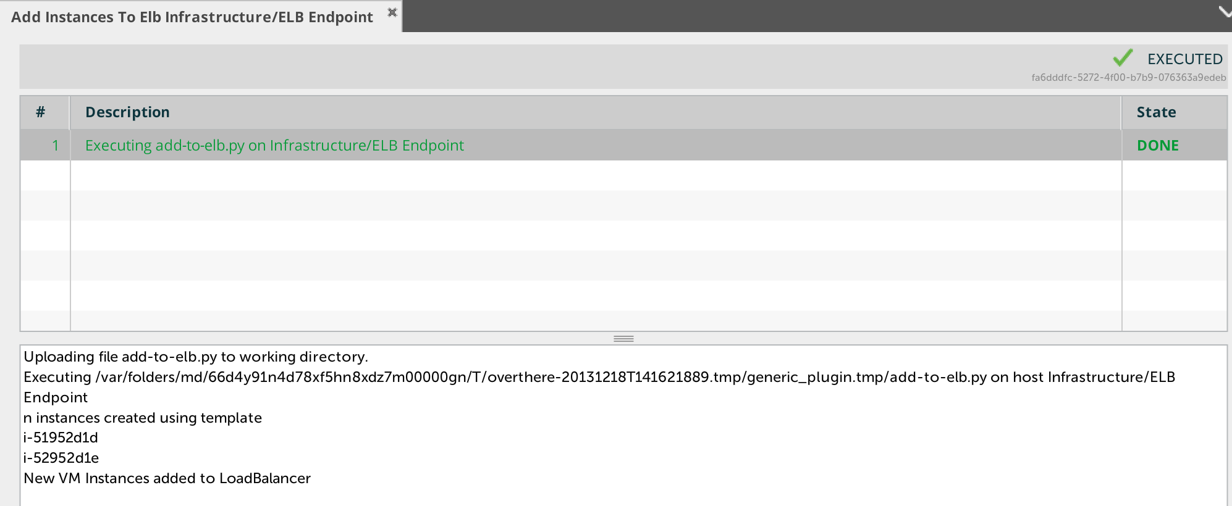
Task created for adding instances to ELB
Task executed and created two instances

Slide 5
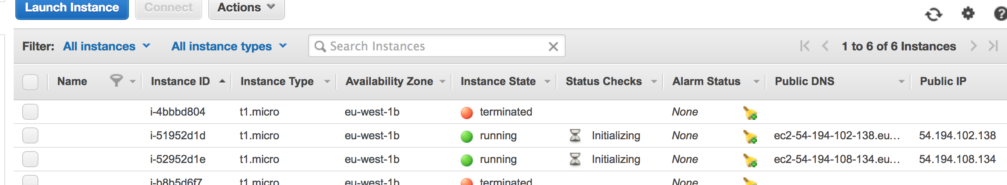
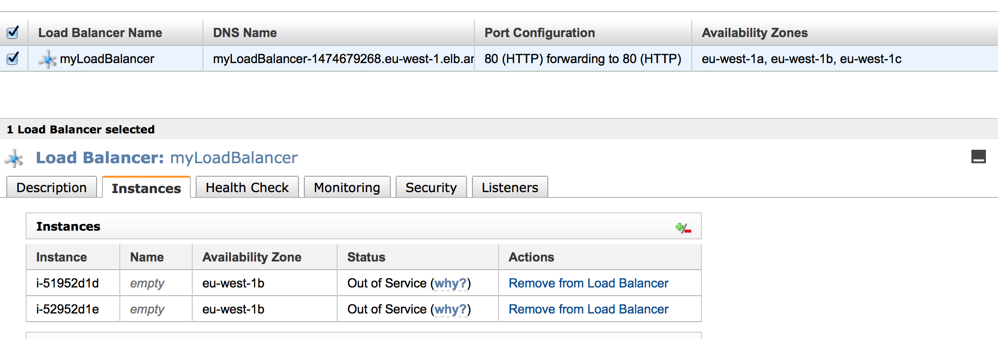
Two instances created on AWS EC2 console in running state
The same two got added to the load balancer

Slide 6
S3 Integration

Slide 7
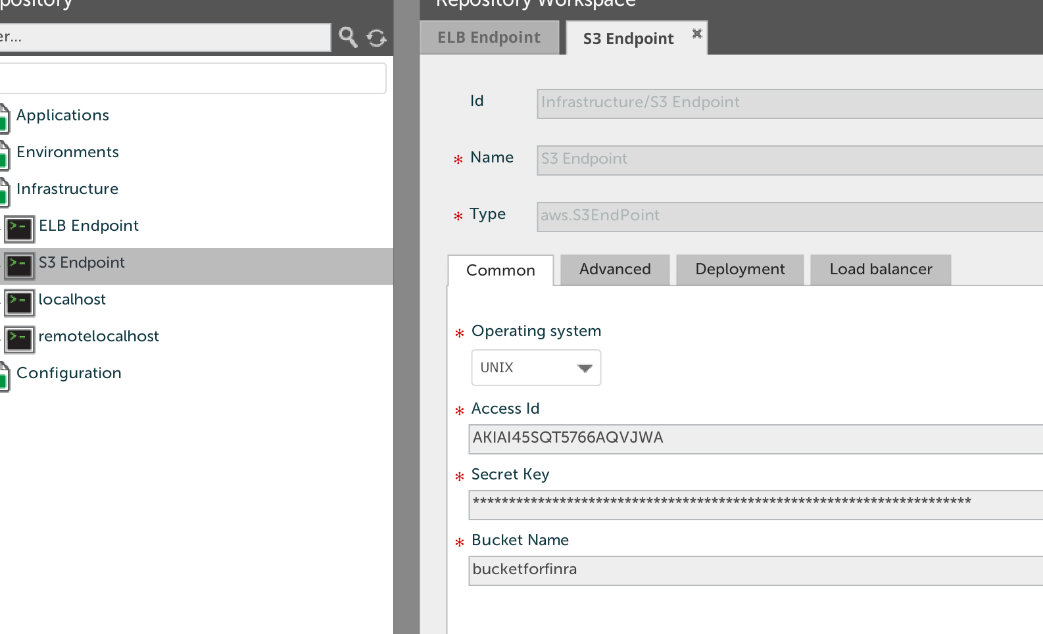
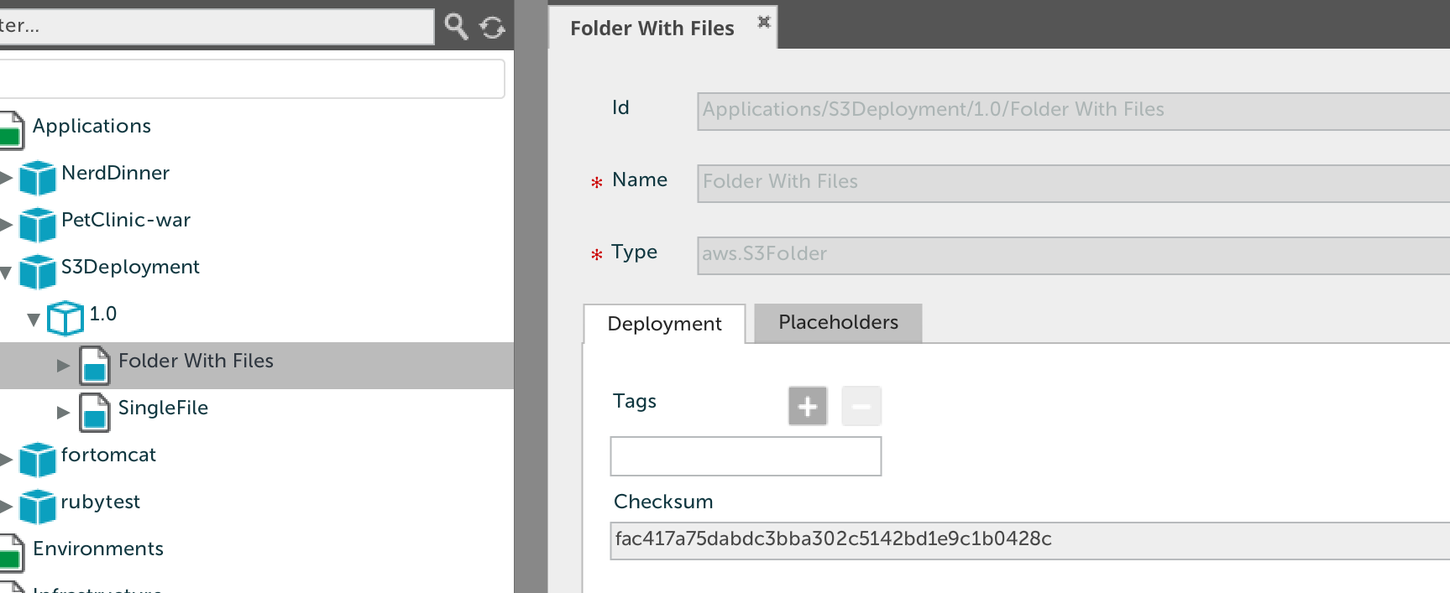
S3 Endpoint type created
Requires
Accessid
Secret Key
Bucket Name
S3 Artifact type created
File type for single file
Folder type for folders

Slide 8
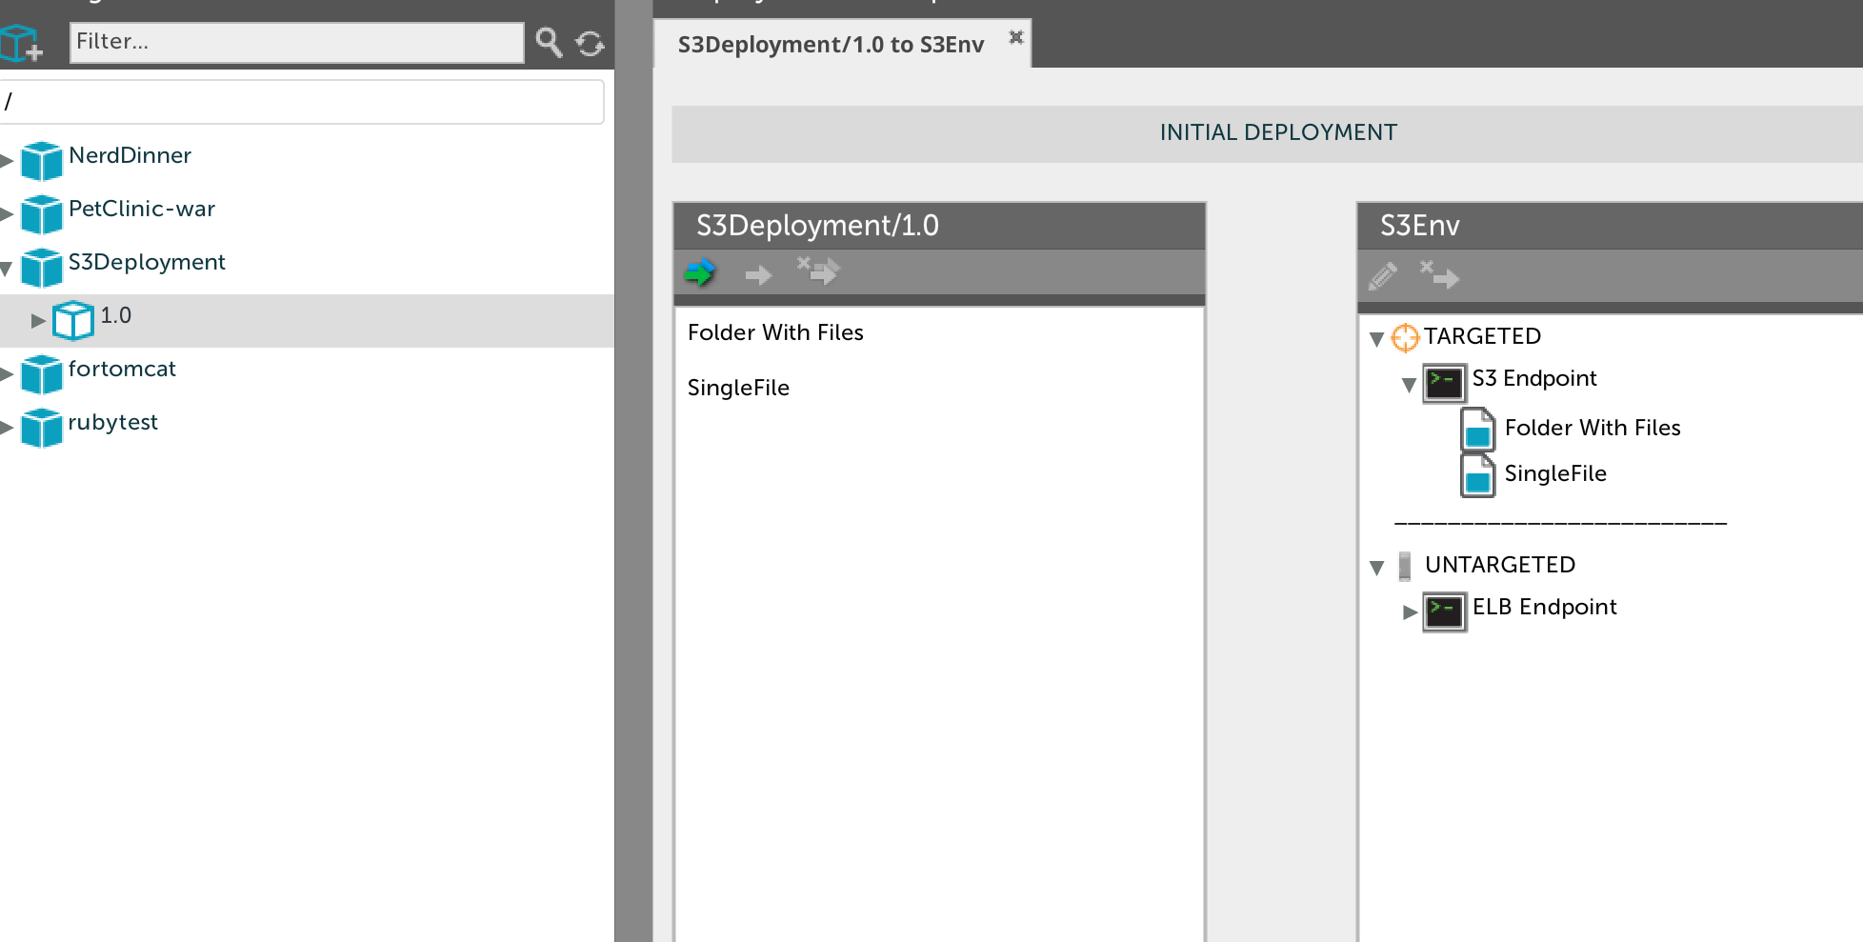
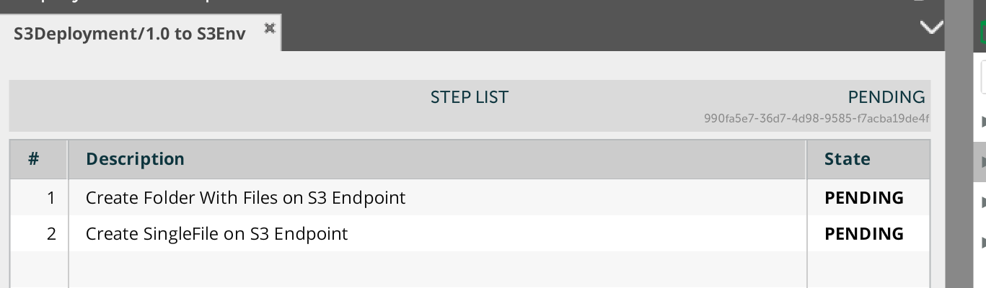
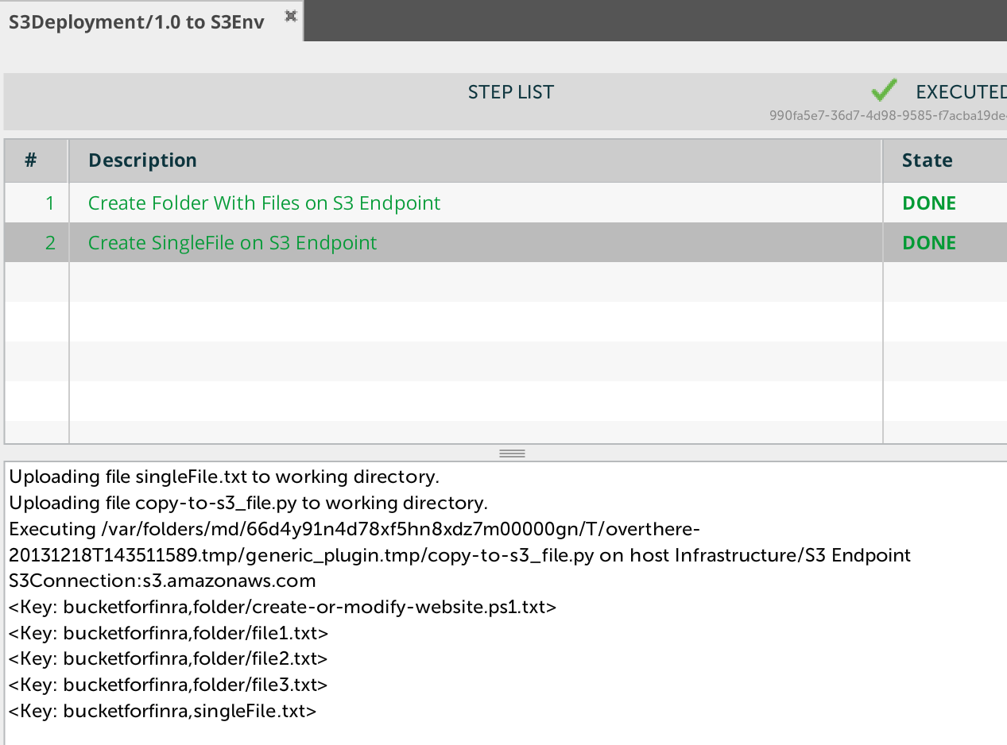
File map automatically to S3 Endpoint container on deployment start
Starting deployment
Successful Deployment

Slide 9
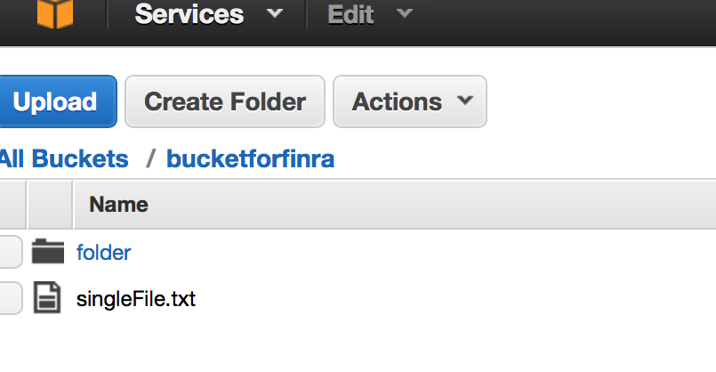
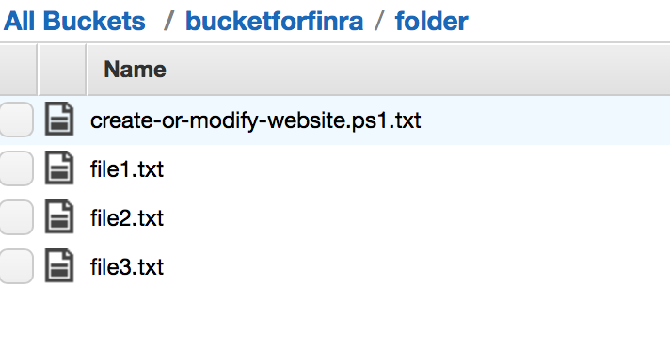
Folder and single file created
At the root level inside bucket
Contents of the folder placed
Successfully inside the folder

